Slide 1
Violence Detection in Crowd using Deep Learning
Foundations of Computer Vision
Final Project Presentation
Varun Mantri (vm9324@g.rit.edu)
Sanket Sheth (sas6792@g.rit.edu)

Slide 2
Agenda
Motivation
Data
Model Architecture
Experimentation
Results
Conclusion
References
A 5-Minute Tour...

Slide 3
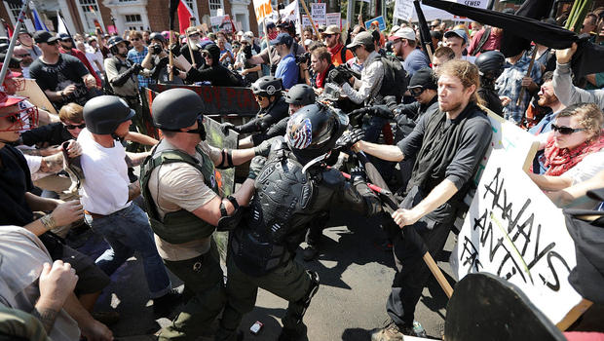
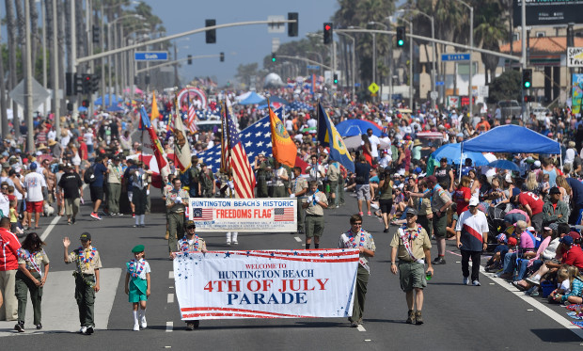
Motivation
Video Surveillance on the rise all over the world.
Varied behavior in crowds.
Distinction between violent and non-violent behavior.
Creating a system to detect this by means of machine learning.

Slide 4
Data
The data is acquired from a similar research conducted by T. Hassner, Y. Itcher and O. Kipler-Gross.
The data contains video files of crowd based violent and non-violent acts and are annotated.
There are about 246 videos which are converted to frames of images for further processing using openCV.
The number of frames for violent data is 12407 while the number for non-violent frames is 9421.
The data is then scaled down as CNN’s require fixed size of feature vectors thus the 320 x 240 sized images are converted to 64 x 48 sized images using matlab.

Slide 5
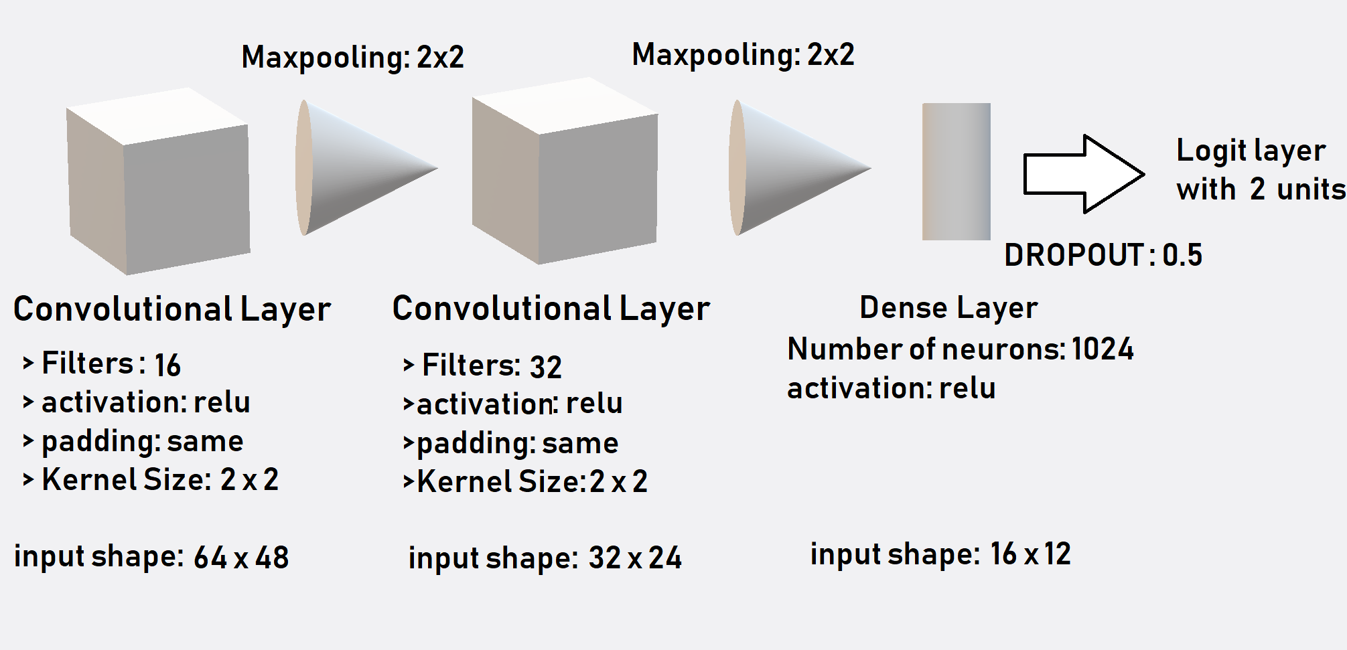
Model Architecture

Slide 6
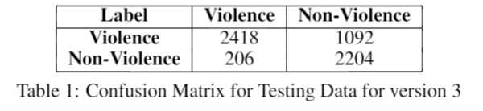
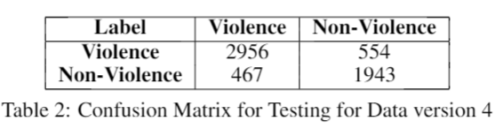
Experimentation
EX NO. 1: Number of epochs 30,
Dropout of 0.2,
No Batch Normalization
EX No. 2: Number of epochs 100,
Dropout of 0.5
No Batch Normalization

Slide 7
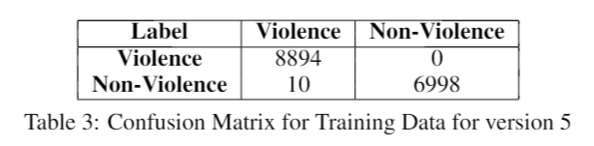
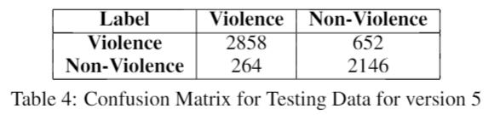
Results and Discussion
Number of epochs 100,
Dropout of 0.5,
Batch Normalization used.
Training Accuracy: 99.93%
Testing Accuracy: 84.52%

Slide 8
Conclusion
In conclusion, a classification model is achieved that classifies frames of video files of crowd into acts of violence or non-violence using computer vision and deep learning.
The model works fairly well, and the next step is to convert the system to be able to work with real time surveillance data.
By using a larger and more varied data set the results achieved can be improved drastically.
Also, can be used to generate a desktop application for monitoring and security purposes at law enforcement locations.
This model can be extended to detect more crowd based behavior beyond violent and non-violent actions.

Slide 9
References
O. Boiman and M. Irani. Detecting irregularities in images and in video. In Tenth IEEE International Conference on Computer Vision (ICCV’05) Volume 1, volume 1, pages 462–469 Vol. 1, Oct 2005. doi: 10.1109/ICCV.2005.70.
P.A. Crook, V. Kellokumpu, G. Zhao, and M. Pietikainen. Human activity recognition using a dynamic texture based method. In Proceedings of the British Machine Vision Conference, pages 88.1–88.10. BMVA Press, 2008. ISBN 1-901725-36-7. doi:10.5244/C.22.88
P. Dollar, V. Rabaud, G. Cottrell, and S. Belongie. Behavior recognition via sparse spatio-temporal features. In 2005 IEEE International Workshop on Visual Surveillance and Performance Evaluation of Tracking and Surveillance, pages 65–72, Oct 2005. doi: 10.1109/VSPETS.2005.1570899.
.Avishai Hendel, Daphna Weinshall, and Shmuel Peleg. Identifying Surprising Events in Videos Using Bayesian Topic Models, pages 448–459. Springer Berlin Heidelberg, Berlin, Heidelberg, 2011. ISBN 978-3-642-19318- 7. doi: 10.1007/978-3-642-19318-7_35. URL https://doi.org/10.1007/978-3-642-19318-7_35.
J. Liu, Jiebo Luo, and M. Shah. Recognizing realistic actions from videos ’in the wild’;. In 2009 IEEE Conference on Computer Vision and Pattern Recognition, pages 1996–2003, June 2009. doi: 10.1109/CVPR. 2009.5206744.
Y. Itcher T. Hassner and O. Kliper-Gross. Violent flows: Real-time detection of violent crowd behavior. In 3rd IEEE International Workshop on Socially Intelligent Surveillance and Monitoring (SISM) at the IEEE Conf. on Computer Vision and Pattern Recognition (CVPR), June 2012. URL www.openu.ac.il/home/ hassner/data/violentflows/.
G. Zhao and M. Pietikainen. Dynamic texture recognition using local binary patterns with an application to facial expressions. IEEE Transactions on Pattern Analysis and Machine Intelligence, 29(6):915–928, June 2007. ISSN 0162-8828. doi: 10.1109/TPAMI.2007.1110.

Slide 10
QUESTIONS?

Slide 11
fin.

